Slide 1


ECEN 403 Final Presentation Team #98 ECEN 215 Lab Kit Luis Diaz-Santini, Yusuf Hossain,
Ryan Freed, and Peter Zhang Dr. Lusher

Slide 2
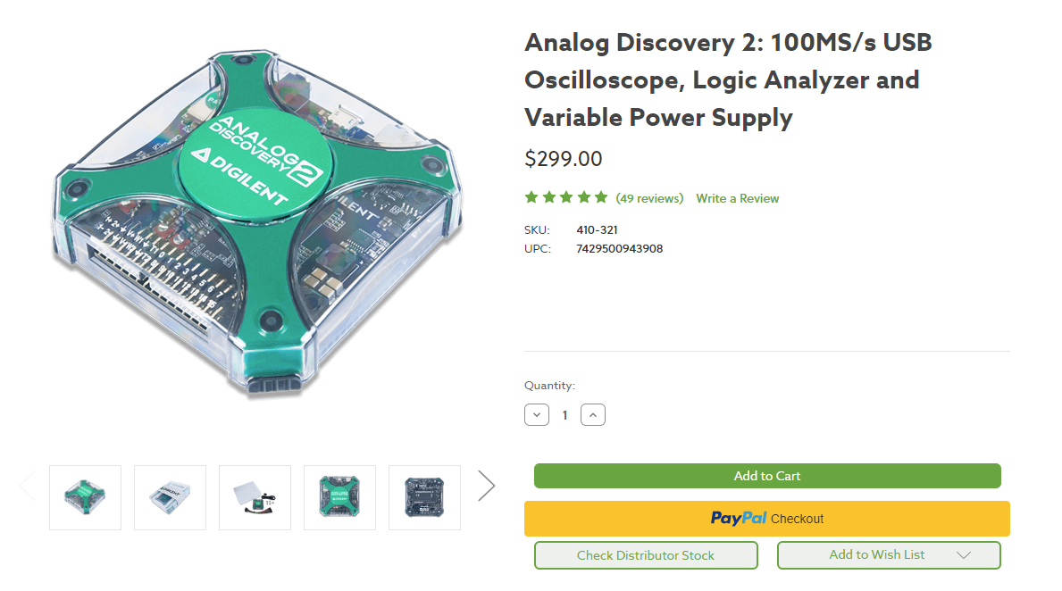
Project Overview
Problem: Electrical engineering tools can be pricey and complex for new users exploring the topic. This forms a financial barrier for new students taking ECEN 215 at TAMU if they are unable to attend on campus lessons.

Slide 3
Problem Solution
Develop a device with the following features to improve accessibility of ECEN 215 labs
Mobile
Cheap
Multimeter
Oscilloscope
Signal Generator
Can be accessed through a mobile interface

Slide 4
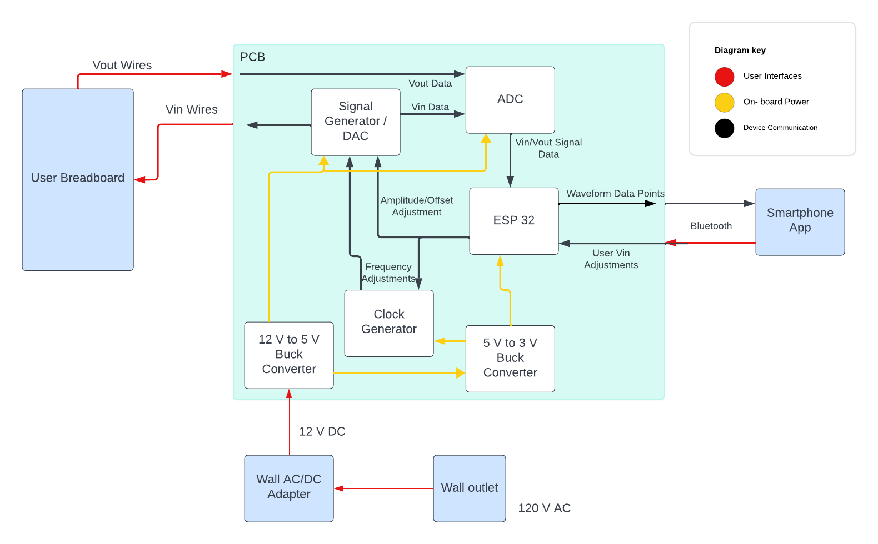
Subsystems & Block Diagram
Peter:
Multimeter and Oscilloscope
Yusuf:
Waveforms and communicating to the microcontroller.
Luis:
Create mobile application to interface with device
Ryan:
PCB design and power.

Slide 5
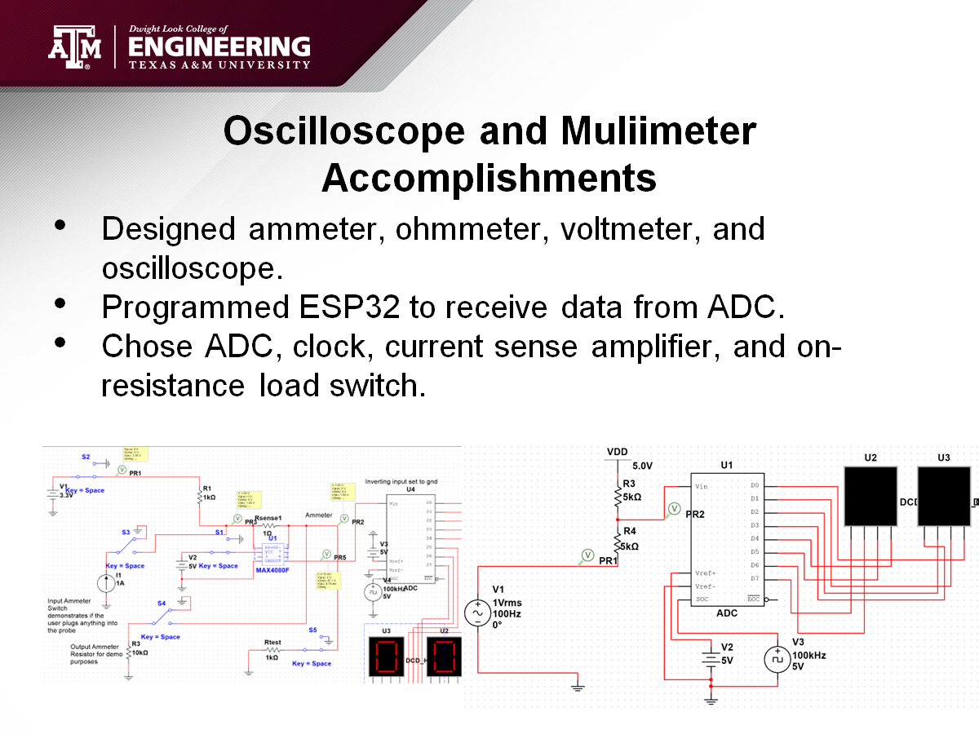

Slide 6
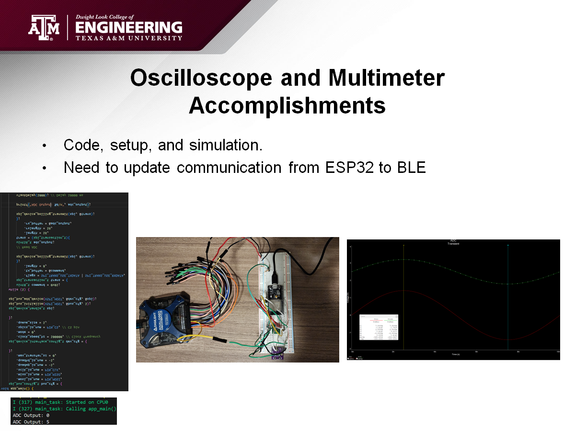

Slide 7
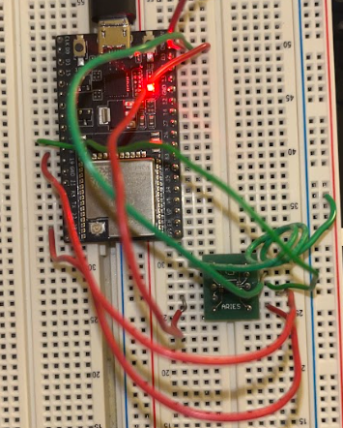
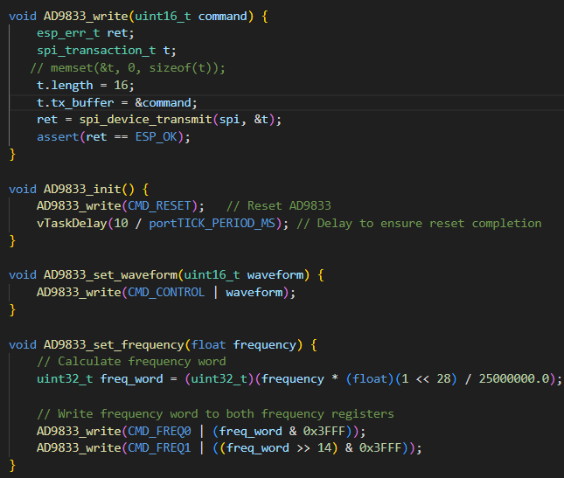
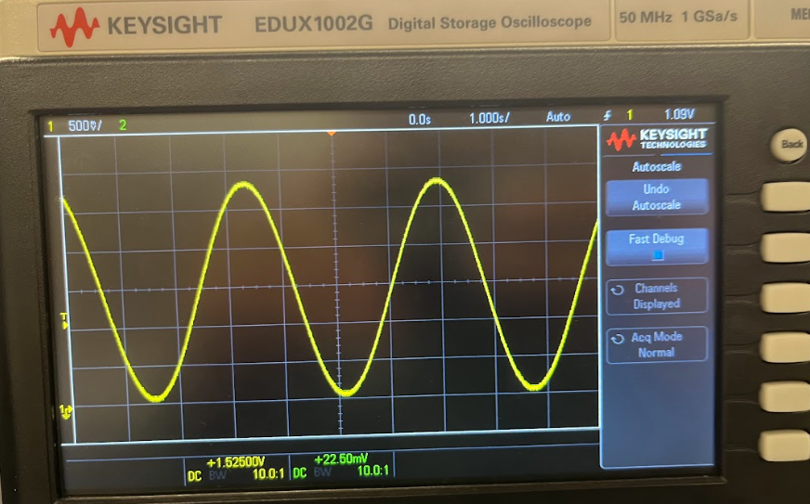
Wavegen Design Accomplishments
Designed sine, triangle and square waveforms with adjustable frequencies.
Chose Wavegen, amplifier, and microcontroller.

Slide 8
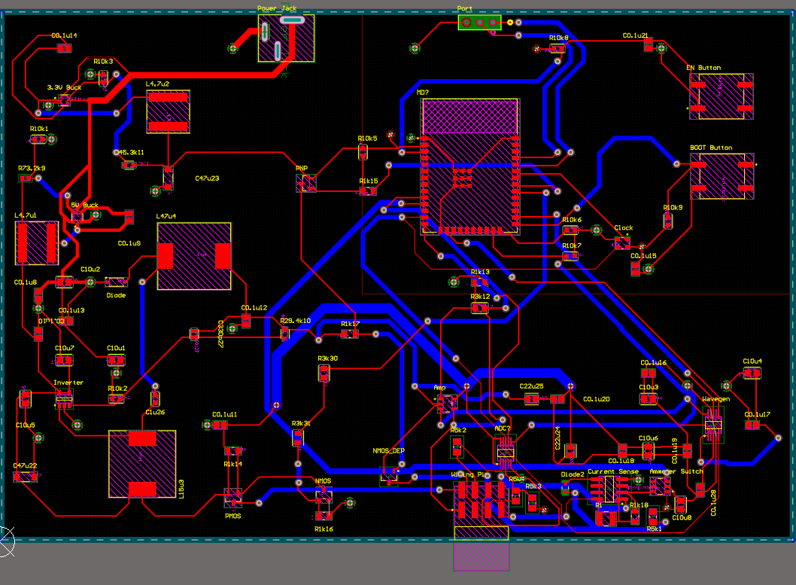
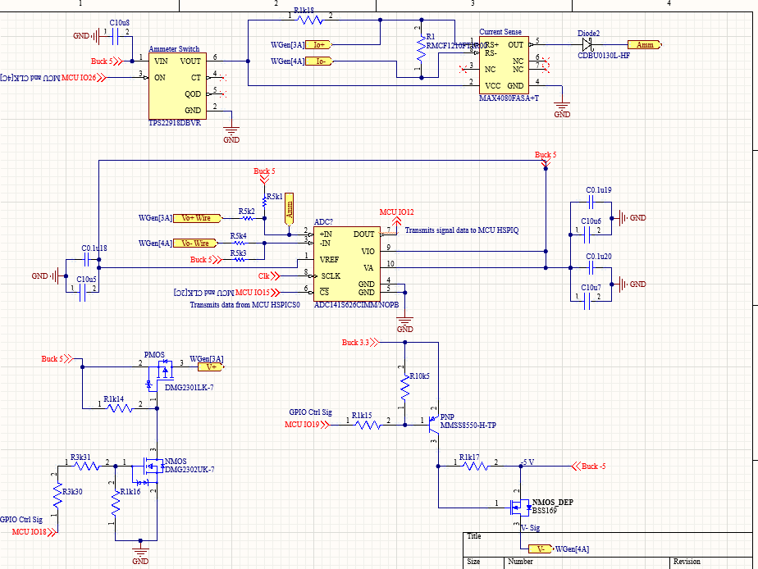
PCB Design Accomplishments
Altium Schematic and PCB Design
Board Layout ADC/Power Supply Schematic

Slide 9
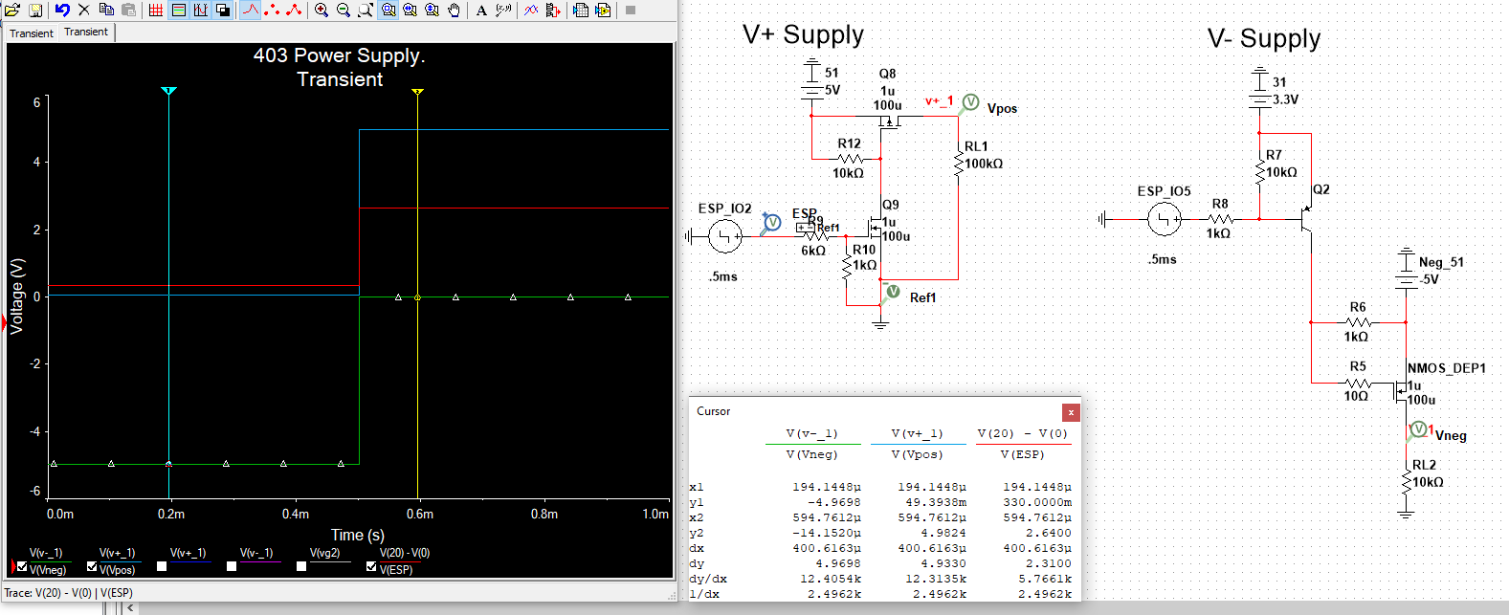
PCB Design Accomplishments
Power Supply Design and Simulation
Component Selection (Exceptions: ADC, Clock, MCU, and Ammeter)

Slide 10
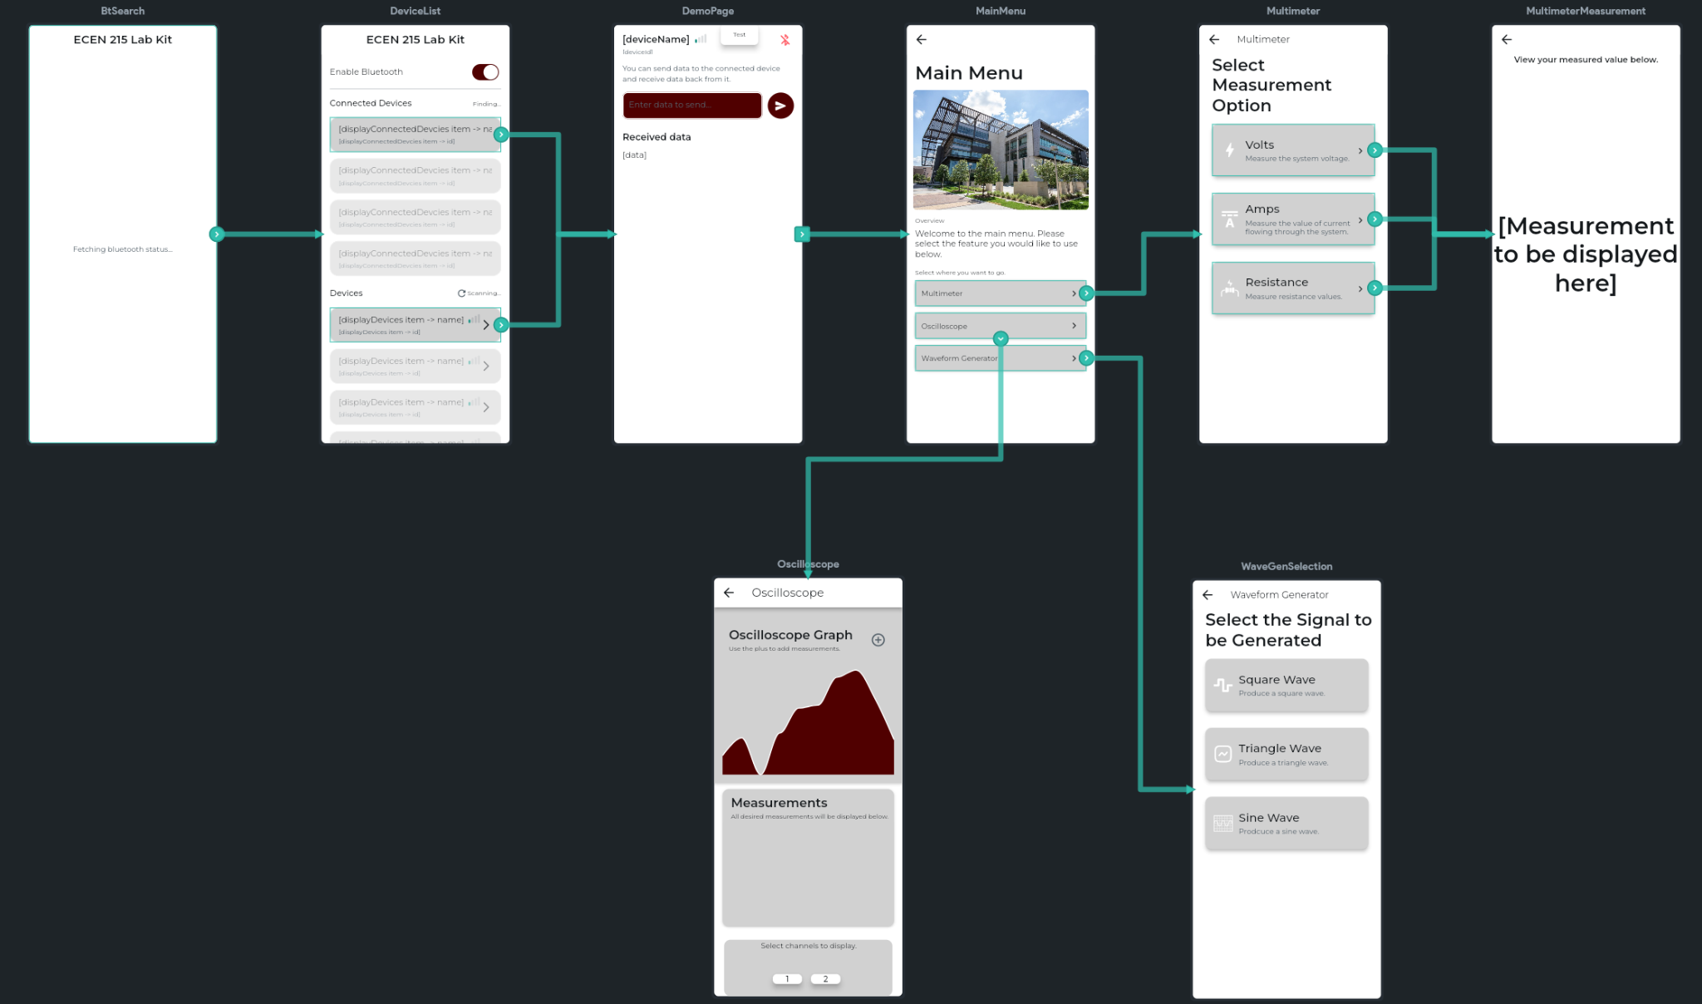
App Development Accomplishments
Application Pages/Storyboard:

Slide 11
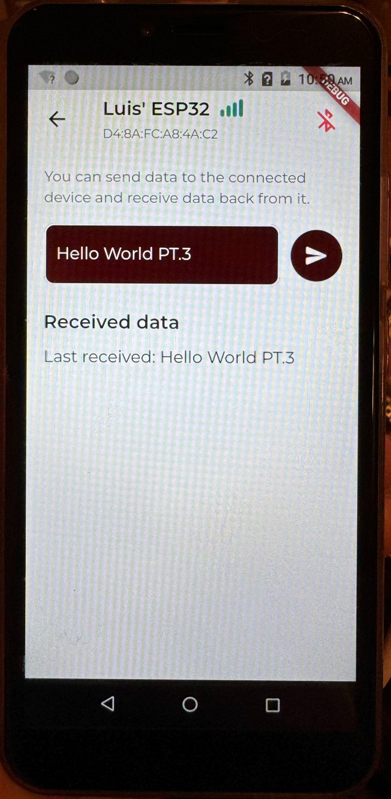
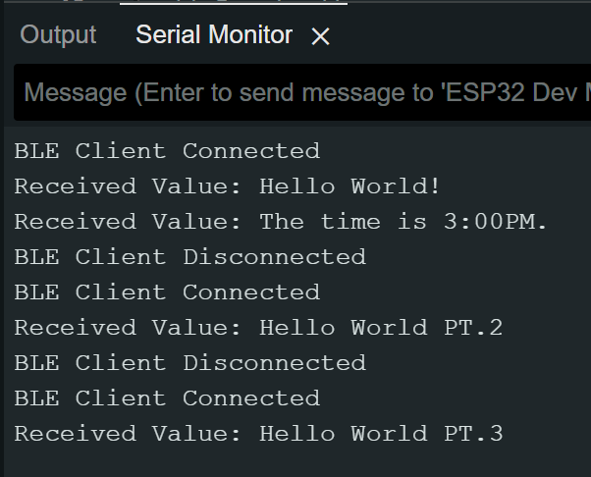
App Development Accomplishments
BLE works (at least one way for now)
Able to send messages to ESP32
Have to debug code to receive messages from ESP32

Slide 12
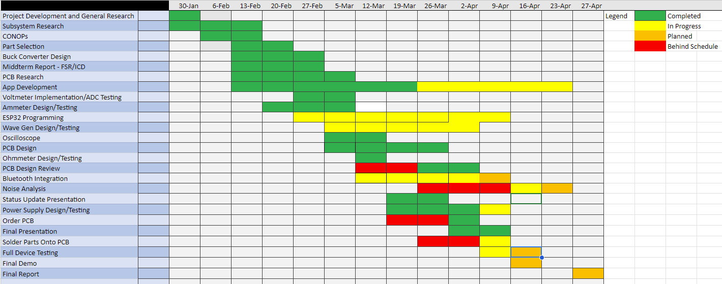
Execution Plan

Slide 13
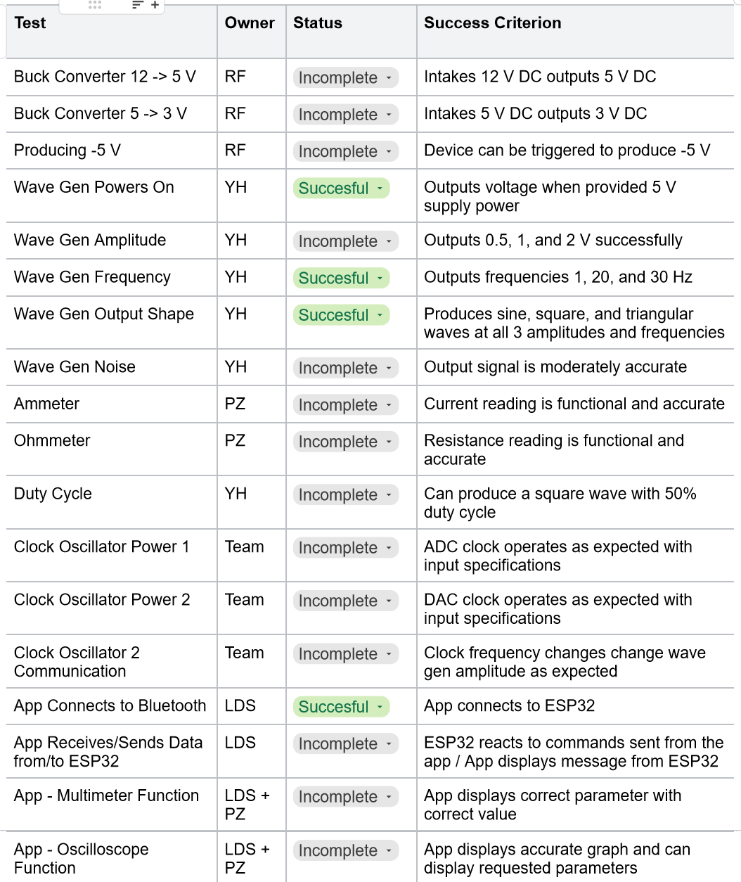
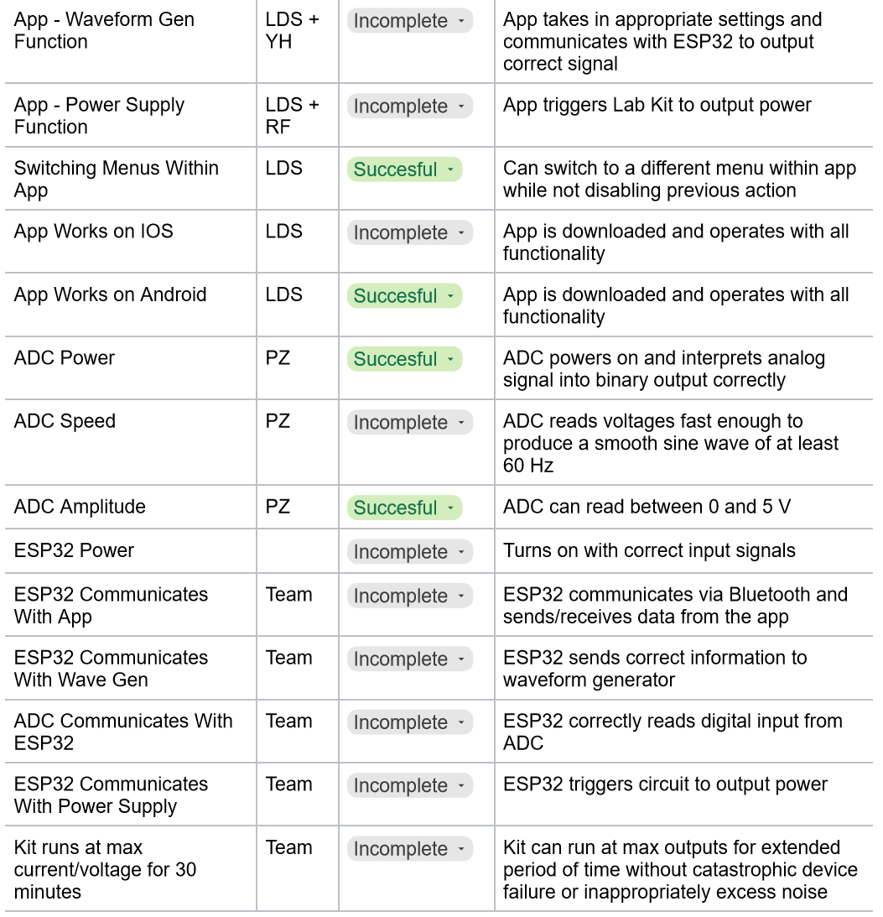
Validation plan

Slide 14
Remaining Tasks
Incomplete: Receive PCB, solder on components, testing.
Looking ahead:
PCB - Noise reduction, casing design, potential heat management, PCB modifications.
Oscilloscope / Multimeter - Increase measurement accuracy, reduce noise, integrate with app.
App - Debug ESP32 code to send message to app, setup button functionality and communication within app, integration with other systems.
DAC - Increase accuracy, amplify voltage to desired amounts, and integrate with app.

